Slide 1

Chapter 5 – part II

Slide 2
OUTLINE
  Friction force.
  Circular motion.
  Problems.

Slide 3
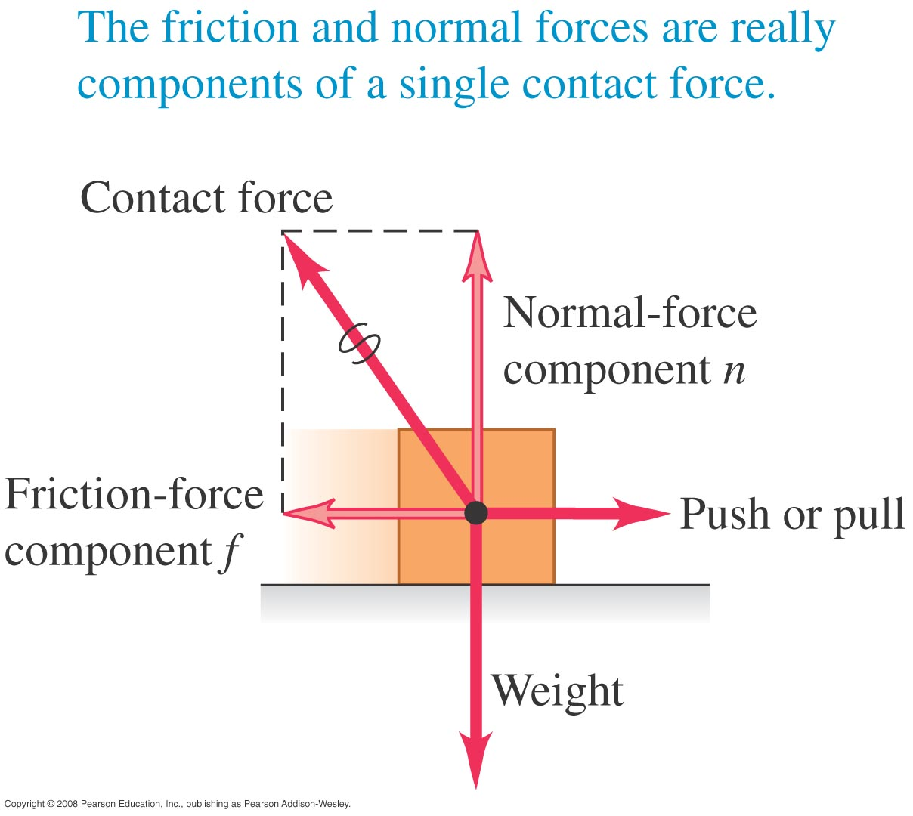
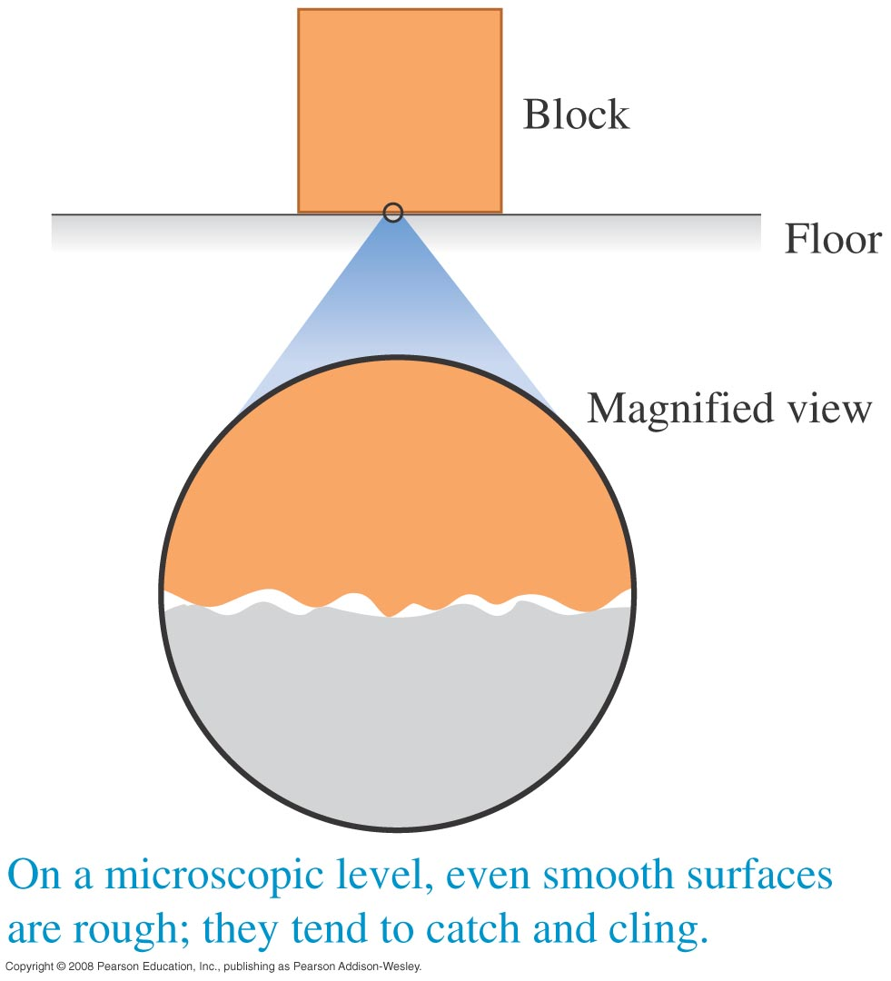
Frictional forces
When a body rests or slides on a surface, the friction force is parallel to the surface.
Friction between two surfaces arises from interactions between molecules on the surfaces.

Slide 4
Kinetic and static friction
Kinetic friction acts when a body slides over a surface.
The kinetic friction force is f_{k} = µ_{k}n.
Static friction acts when there is no relative motion between bodies.
The static friction force can vary between zero and its maximum value: f_{s} ≤ µ_{s}n.

Slide 5
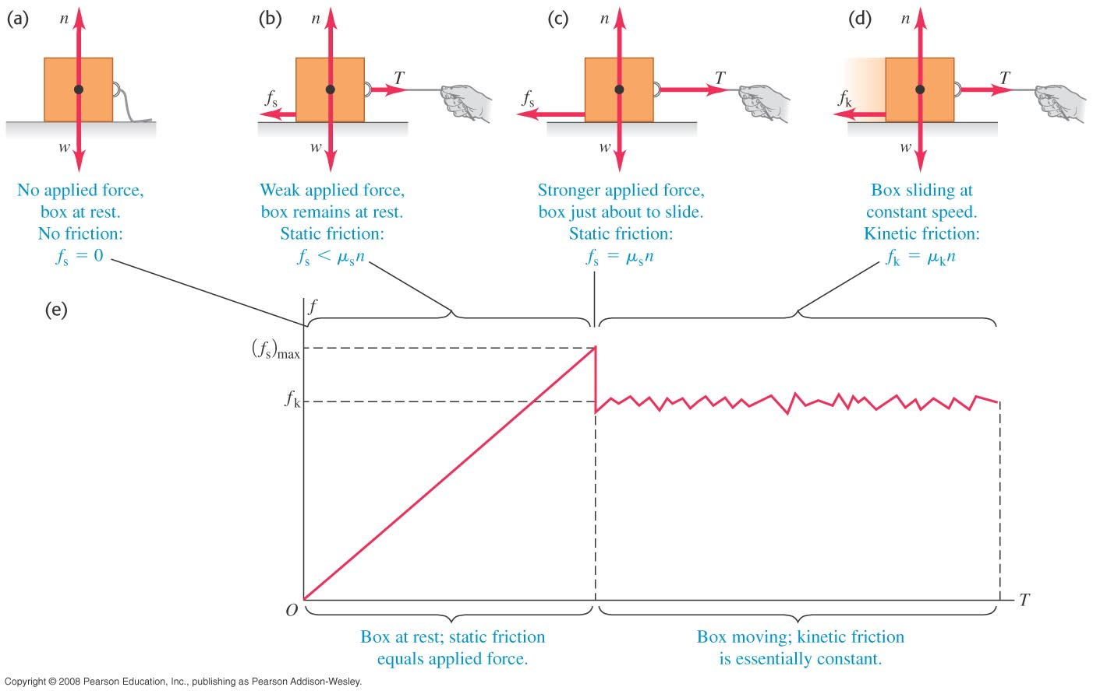
Static friction followed by kinetic friction
Before the box slides, static friction acts. But once it starts to slide, kinetic friction acts.

Slide 6
Static friction can be less than the maximum
Static friction only has its maximum value just before the box “breaks loose” and starts to slide.

Slide 7
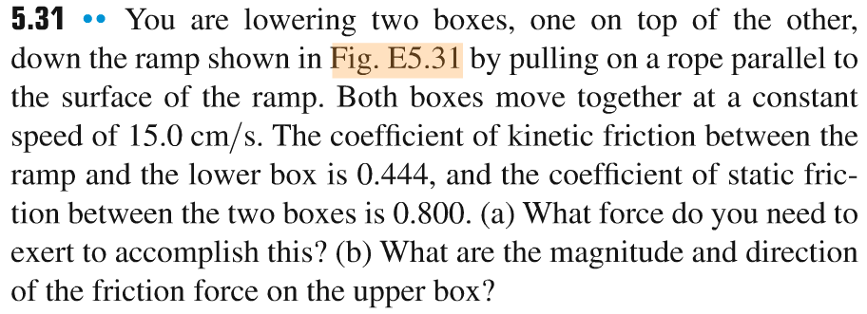
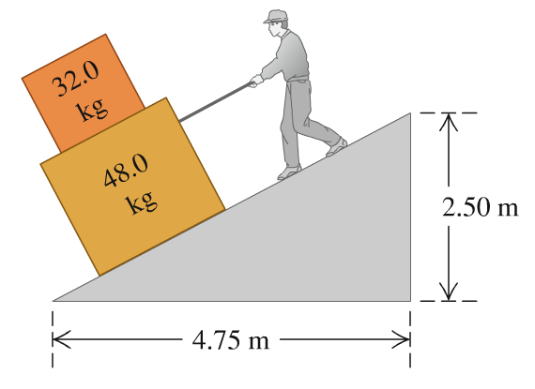
Problem #1

Slide 8
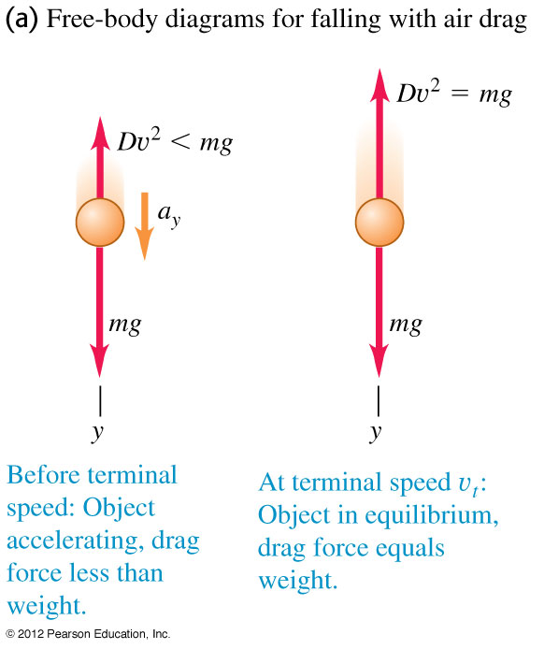
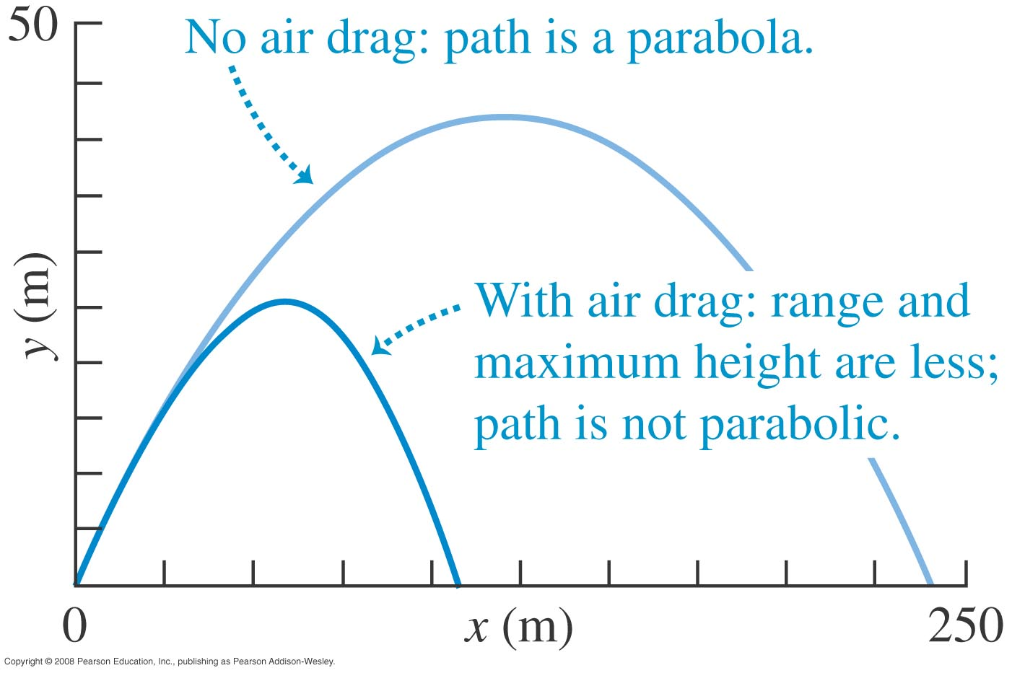
Fluid resistance and terminal speed
The fluid resistance on a body depends on the speed of the body.
A falling body reaches its terminal speed when the resisting force equals the weight of the body.
The figures at the right illustrate the effects of air drag.

Slide 9
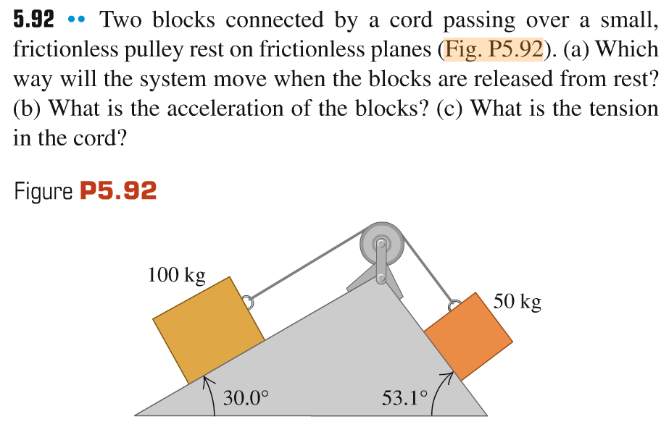
Problem #2

Slide 10
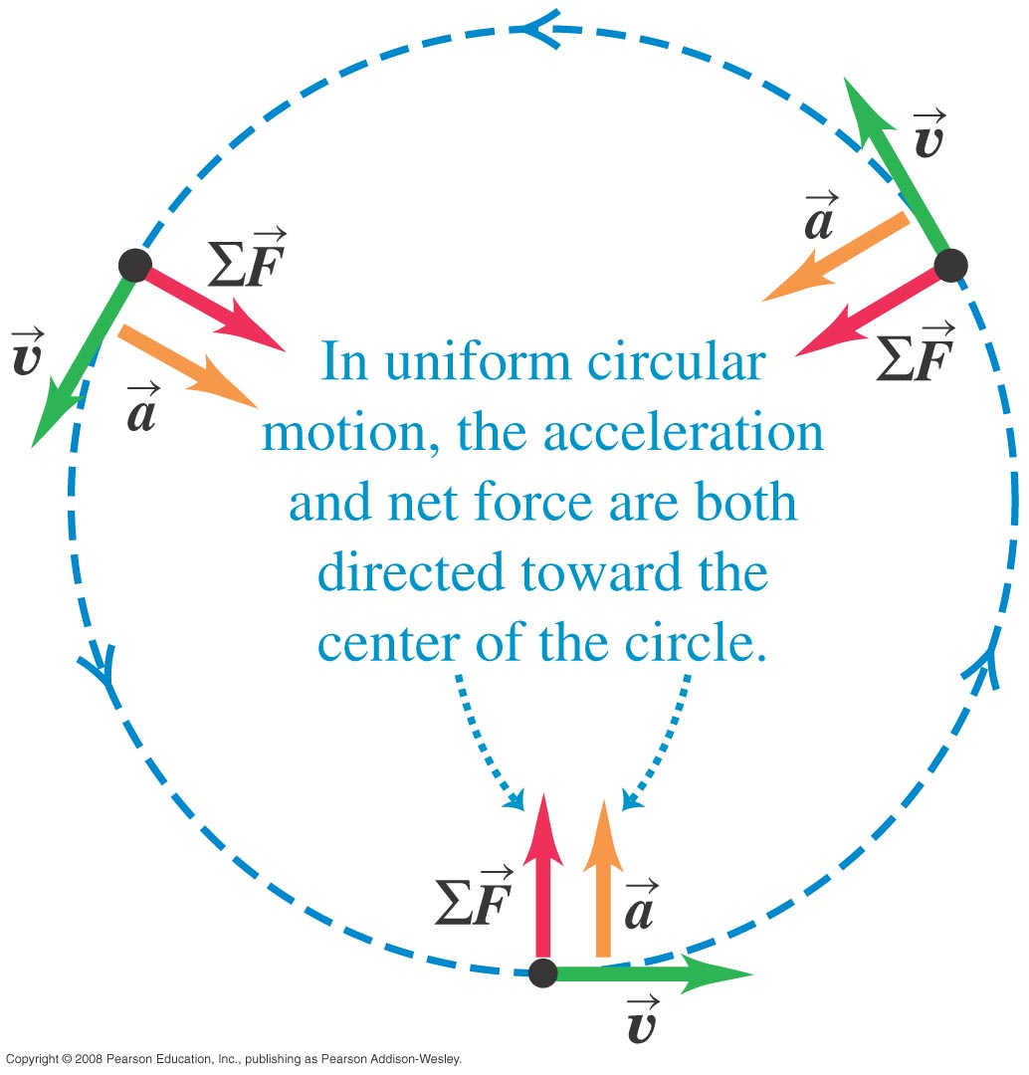
Dynamics of circular motion
If a particle is in uniform circular motion, both its acceleration and the net force on it are directed toward the center of the circle.
The net force on the particle is F_{net} = mv²/R.

Slide 11
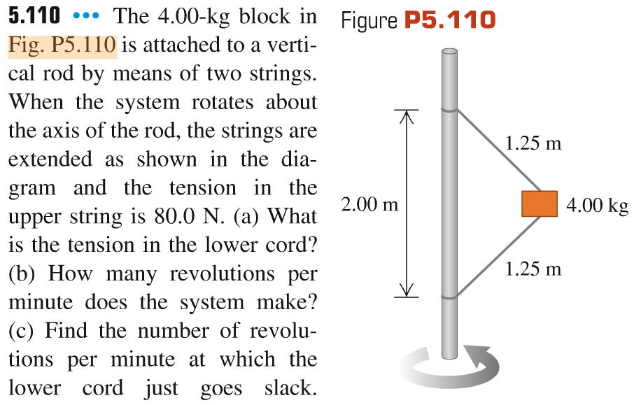
Problem #3

Slide 12
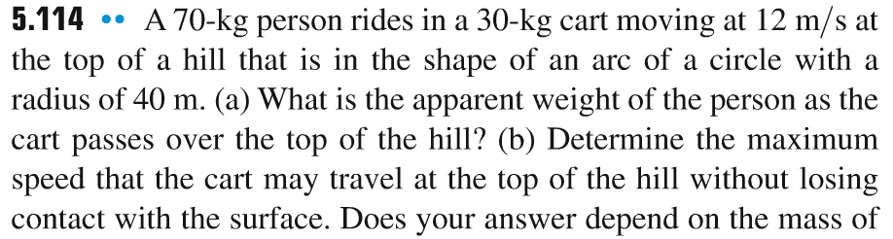
Problem #4

Slide 13
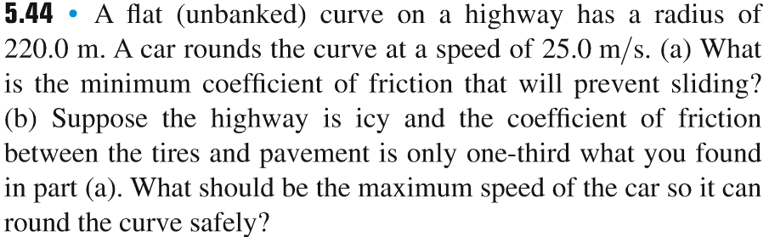
Problem #5

Slide 14
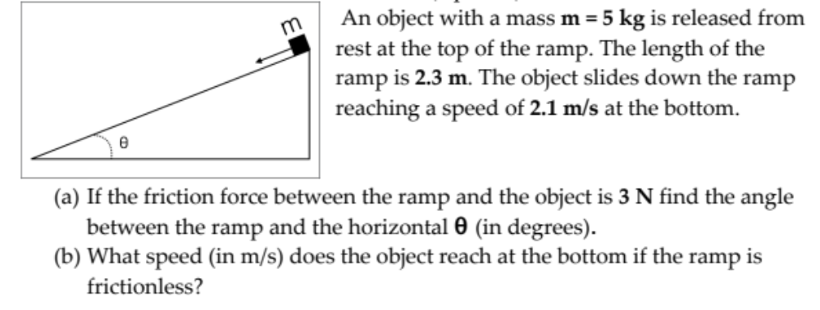
Problem #6

